Slide 1
Key Features of Spoken Presentations
Flori Tulli
Notes:
Hello hello, and welcome back to Key Features of Spoken Presentations. My name is Flori Tulli, and I'll guiding you through the second part of this series.

Slide 2
Structure
Considering Visuals
Notes:
In the first part of our series, we talked about our first key feature of spoken presentations: Structure. In this part, we'll talk about our second key feature: Considering Visuals.

Slide 3
Considering Visuals
Notes:
While not every speech needs them, properly implementing visuals can allow us to better engage our audience. When it comes to explaining ideas to an audience, think of the saying "show don't tell."

Slide 4
Signpost language
Cues help listeners follow your text.
Transitions lead from one point to the next.
Stop and summarize complex points.

Slide 5
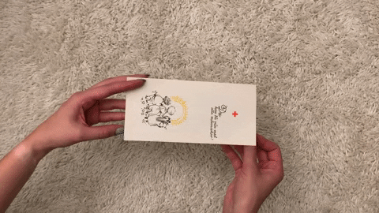
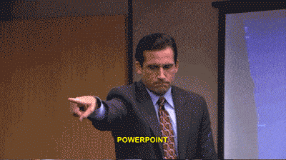
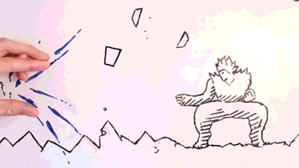
Use visuals!
Notes:
Visuals can be a very fun creative way of expressing our ideas to an audience. There are many digital and hard-copy resources you can use for a presentation.
Powerpoints can be effective tools at combining both textual and visual information. This software allows us to insert images, icons, gifs, and links that can compliment our speech.
We can also consider giving handouts to our audience, such as flyers or surveys.
Another option we can consider is using our presentation space. Instead of a software, we can always use a whiteboard or blackboard to outline ideas and drawings.
There are a lot of options we can consider that allow us to get creative.

Slide 6
in Presentations

Slide 7
In conclusion, powerpoints are an effective tool to present information. If you ask me, everyone should practice public speaking using powerpoints. They’re entertaining, interesting, and engaging. Although, powerpoints can also be very boring, especially if you read straight from your slides, list too much information, use unreadable fonts and colors, don’t take time to explain big concepts, or don’t use any visuals. If you avoid these, you’ll be ok. As some professor once told me, “practice practice practice!” That’s what you should do, with a fellow classmate or maybe a writing tutor. Make sure you practice, time yourself, and review your slides. If you do this, you’ll do great! If you made it this far, I commend you ☺
Notes:
There are several elements on this slide that are distracting to our audience.
We want to avoid overly vibrant colors, unreadable font, and presenting too much information at once.

Slide 8
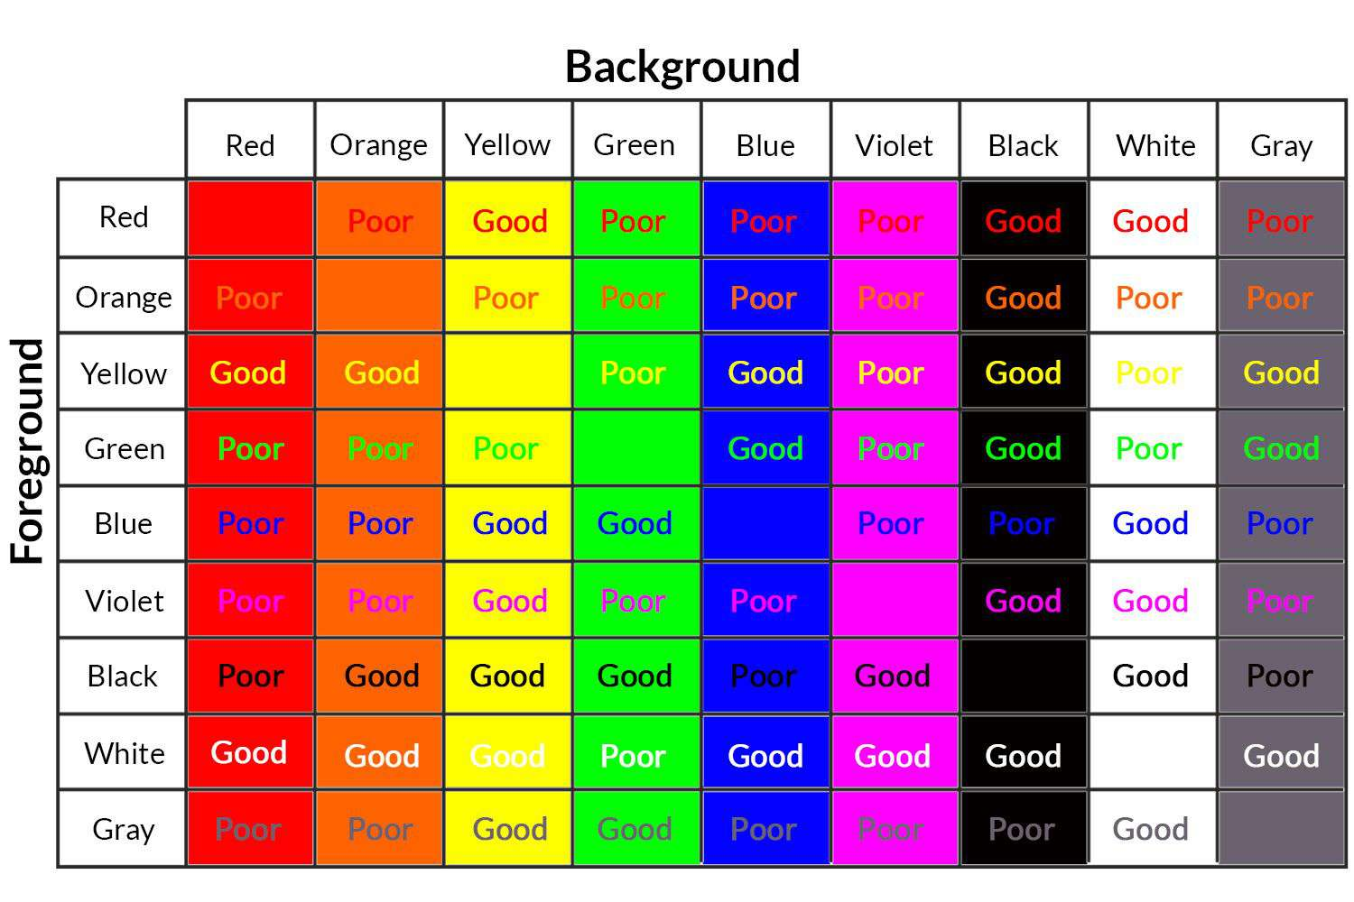

Slide 9
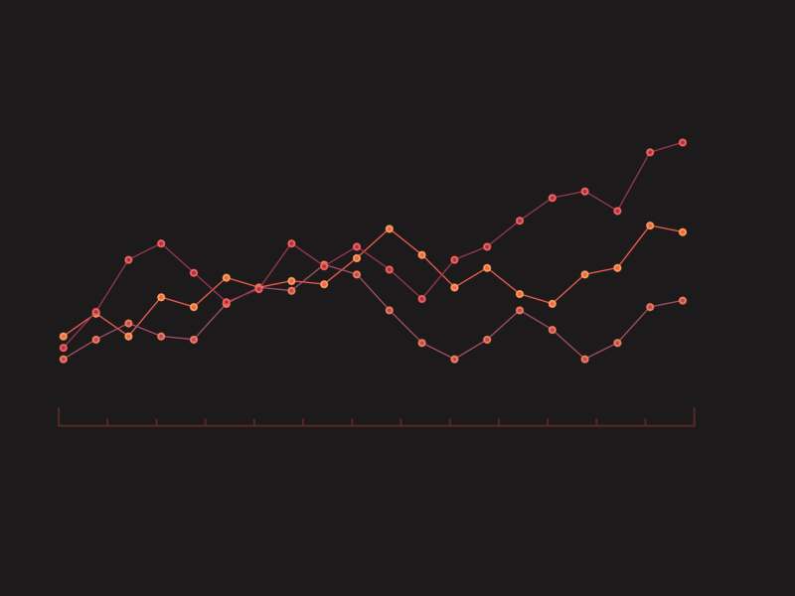
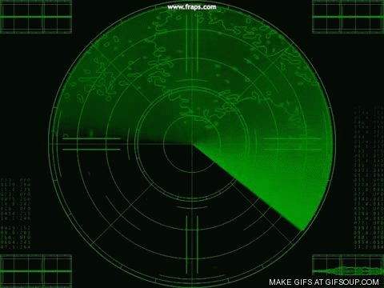
Infowhelm
Woah!
Hold on!
Ahhh!
What’s even happening?
Help!
Notes:
We also don't want to use too many visuals and overwhelm our audience.
Using multiple different fonts, animations, and elements can distract our audience from our ideas.

Slide 10
A decent slide
Point 1
A well-informed point, maybe a statistic or two.
Point 2
Another well-informed point, some of my own analysis.
Point 3
This wraps up all my points and ties back to my thesis.
Notes:
In comparison to the last two slides, this one is much easier to understand. We have title, a few key points, and an image to compliment our ideas.

Slide 11
Structure
Considering Visuals
Preparation
Notes:
So far, in this series about the Key Features of Spoken Presentations, we've reviewed Structure and Considering Visuals. In the third and final part of this series, we'll talk about Preparation. Thanks for joining me today, and I'll meet you at the next part :)

