Slide 1
Third Year Review for Tenure Track and Non-Tenure Track Faculty (as well as those who have a role in the process)
September 26, 2023

Slide 2
Presentation overview
Overview of the Purpose of Third Year Review
Compiling the Dossier
Relevant Stages of the Process
Resources
If you have questions, please “Raise Your Hand” or type your question in the Chat or DM me or Cari to ask a question on your behalf.

Slide 3
Purpose of Third Year Review
FSH 3510 A
GENERAL. In addition to the annual evaluation of faculty by the unit administrator, each full-time, untenured faculty member shall be reviewed by a committee of colleagues during the 24- to 36-month period after beginning employment at UI. The committee shall provide the faculty member with a detailed report regarding the faculty member's progress toward promotion or tenure or both. The third-year review process shall not include a vote of the committee or unit faculty.
In other words, this is a formal opportunity to provide a faculty member feedback about their progress toward tenure and/or promotion.

Slide 4
Promotion
FSH 3500 A-2
Academic rank represents and rewards the individual’s performance as a scholar, teacher, and faculty member.
Promotion to a higher rank is not automatic, but is a decision made on an individual basis subject to university, college, and unit criteria.
Candidates must meet the requirements for the rank based on their responsibility areas (FSH 1565 C) in their position descriptions and the criteria articulated in the unit and/or college bylaws.

Slide 5
Tenure
FSH 3500 A-3
Tenure protects academic freedom in order to maintain a free and open intellectual atmosphere and allows us to attract and retain superior teachers and scholars as members of the faculty.
Tenure is a condition of presumed employment accorded to a faculty member, usually after a probationary period, on the basis of an evaluation and recommendation by a unit committee and administrator, a college committee and dean, a university committee, the provost, and the president.
Tenure is granted only to full-time faculty members who demonstrate they have made and will continue to make significant contributions to their disciplines through effective performance in the responsibility areas in FSH 1565 as specified in their position descriptions and consistent with university, college and unit criteria.

Slide 6
Third year review Process
New policy section as of July 1, 2020—FSH 3510
Normally during the 24-36 months after hire
Candidate submits a Dossier (outlined in FSH 3500 D-minus external peer review).
Committee: same structure as Unit P&T Committee (see FSH 3500 E-1-a)
Final product
Report from committee offering guidance
Unit Administrator report
Candidate response to unit reports
Dean’s report
Candidate response to dean’s report
There is no vote taken from the committee or unit faculty.

Slide 7
dossier

Slide 8
fsh 3500 D-1
Section D: Dossier
D-1 Materials Provided by the Faculty Member
CV in UI format
Candidate Statements (8 page maximum + 1-page COVID Impact Statement)
Part 1: Context Statement
Part 2:Personal Statement of Accomplishment
Evidence of Accomplishment (optional)
Teaching Effectiveness (optional; described in D-2-c)
Optional COVID Impact Statement

Slide 9
Considerations for the Candidate Statement
This is a persuasive document that details an argument for how you are meeting the requirements for promotion and/or tenure.
It is a rarely used genre. It’s helpful to find examples from colleagues who have prepared them and were successful.
It needs to be written for multiple audiences. This is the first draft of the tenure and/or promotion dossier which will be read by many outside of your disciplinary field.
Two parts: Context Statement and the Personal Statement of Accomplishment (8 pages); you can include an optional 1-page COVID impact statement.

Slide 10
Candidate Statement-8 pages total
Context Statement (Descriptive)
Describes candidate’s academic unit and their responsibilities within it as established in the position description.
Can include expectations of interdisciplinary programs, research centers, joint appointments or other special circumstances.
Personal Statement of Accomplishment (Establishing an argument)
An interpretation of the candidate’s record of accomplishment relevant to the responsibilities in their position description and the criteria for promotion and/or tenure.
Provides a philosophical vision for the candidate’s work and explain and analyze specific components.
Helps broader audiences understand the nature of the candidate’s activities so that others can understand the context to assess the work

Slide 11
COVID Impact statement
Optional-detailed in FSH 3500 D-1-b-3
3. COVID Impact Statement (Optional) In one page, the candidate may describe the effects of the pandemic on their work activities and outcomes during the period of review. Candidates may describe such effects across the four areas of consideration: teaching; scholarship and creative activity; outreach and extension; and university service and leadership.

Slide 12
fsh 3500 D-2
Section D: Dossier
D-2 Materials Provided by the Unit Administrator
College and unit Bylaws (annual review and P&T sections)
Position Descriptions (for entire period under review)
Annual Evaluations
Teaching Effectiveness (request course evaluation report from IEA)
Additional Review Letters (interdisciplinary appointments, Centers, etc.)
Please refer to the policy for details!

Slide 13
Unit and College level Third Year review Processes

Slide 14
Unit Third Year Review Committee
Elected by unit faculty (or they may choose to delegate this to the unit administrator)
Five faculty
Must include 3 tenured from the unit and 1 tenured from outside the unit
The committee elects a chair from tenured members
No students or non-university employees
Neither the unit administrator nor the dean may be on the committee
“If there are not three tenured faculty members available to serve on the committee, the unit administrator, in consultation with the dean, shall designate tenured faculty members from other units whose areas of expertise are closely related to the work of faculty in the unit. One such member may chair the committee if there is not a tenured member from the unit available to serve as chair.” (also remember section B-3. Committee Problem Resolution)
The candidate may request the names of the committee members

Slide 15
fsh 3510 D & E unit level review
Unit Third Year Review Committee Report
Evaluates the faculty member’s progress toward promotion and/or tenure in the responsibility areas.
Provide guidance regarding steps necessary to continue making progress toward P&T.
NO VOTE.
Report is forwarded to candidate who may provide a written response within five business days.
Report and any response is sent to the unit administrator.
Template provided!
Unit Administrator Report
Writes a report evaluating candidate’s progress toward P and/or T in light of unit, college, and university criteria and unit committee report.
Provides guidance on steps needed to make progress. Report is forwarded to candidate who may provide a written response within five business days.
Report and any response is sent to the dean.
Template provided!

Slide 16
FSH 3510 E College level review
Dean’s Report
Writes a report evaluating candidate’s progress toward Promotion and/or Tenure in light of unit, college, and university criteria and the reports from the unit committee and the unit administrator.
Provides guidance on steps needed to make progress. Report is forwarded to candidate who may provide a written response within five business days.
All materials are compiled here and are sent to the provost’s office.
Template provided!

Slide 17
resources

Slide 18
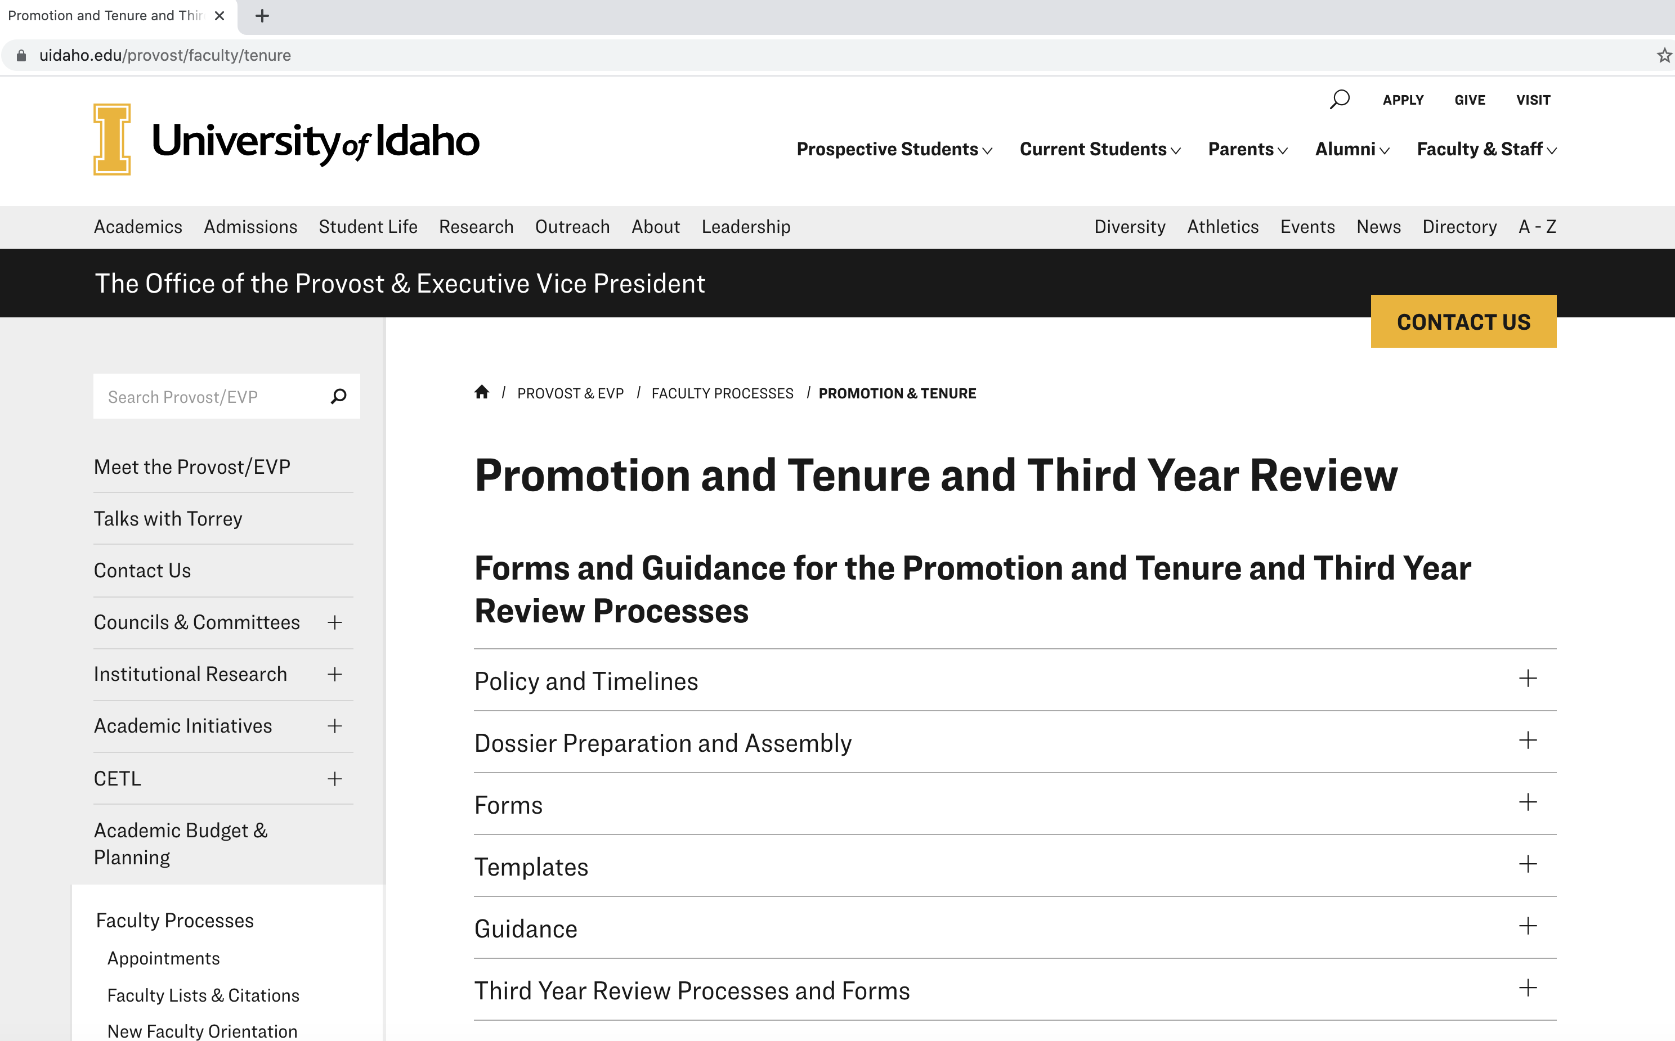
Resources: uidaho.edu/provost/faculty/tenure

Slide 19
Website resources
Office of the Provost & Executive Vice President
→ Faculty Processes
→ Promotion & Tenure
https://www.uidaho.edu/provost/faculty/tenure
Policy and Timelines (link to FSH 3510)
Dossier Preparation and Assembly
Guidance (All of the training videos)
Third Year Review Processes and Forms

Slide 20
Thank you
For further assistance:
www.Uidaho.edu/provost
provost@uidaho.edu

